Slide 1

AESTHETIC
Cured cases

Slide 2

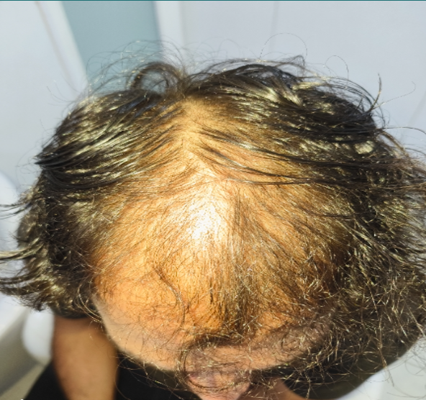
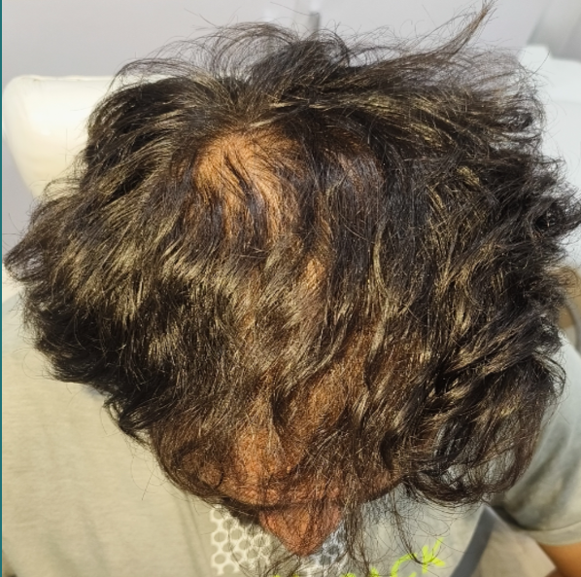
Dr Name: Dr Amrita Sahni
Clinic Name: Janakpuri
Sessions done: 6 sessions
Therapy taken: XOGEN
Therapsit name: Manpreet Kaur
Notes:
Enquiry Id : 110006414674

Slide 3
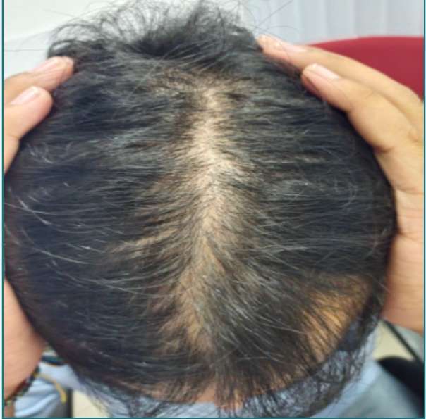
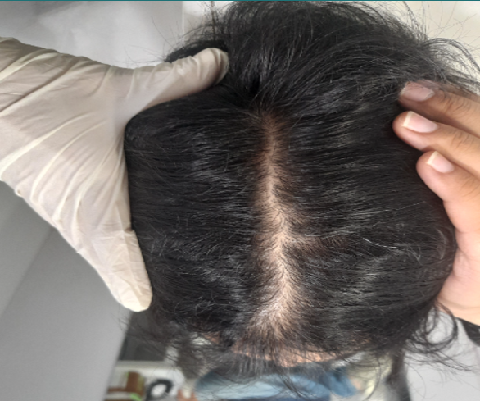
Dr Name: Dr Kapil Chawla
Clinic Name: Karol bagh
Sessions done: 6 sessions
Therapy taken: XOGEN
Therapsit name: Pooja
Notes:
Enquiry Id : 110006921240

Slide 4
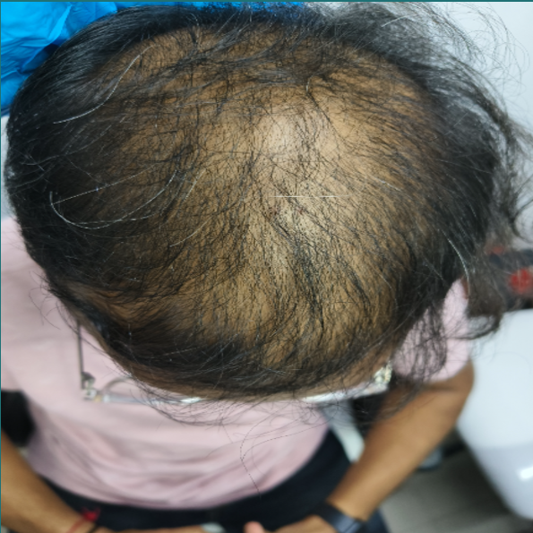
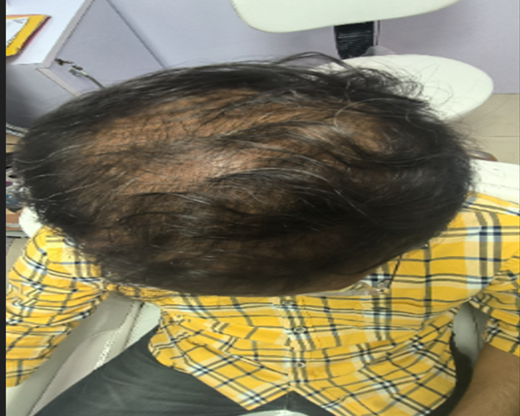
Dr Name: Dr Shweta Tiwari
Clinic Name: Pitampura
Sessions done: 6 sessions
Therapy taken: XOGEN
Therapsit name: Neetu
Notes:
Enquiry Id : 110008403232

Slide 5
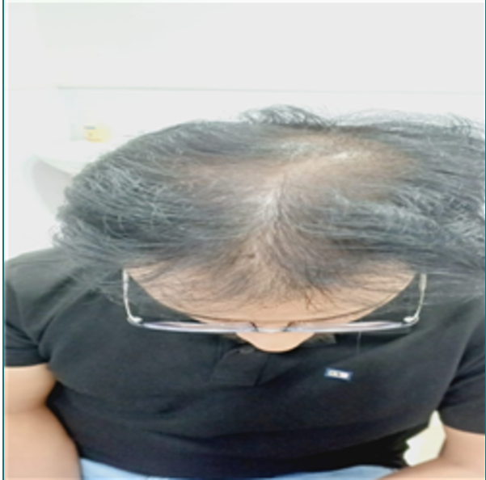
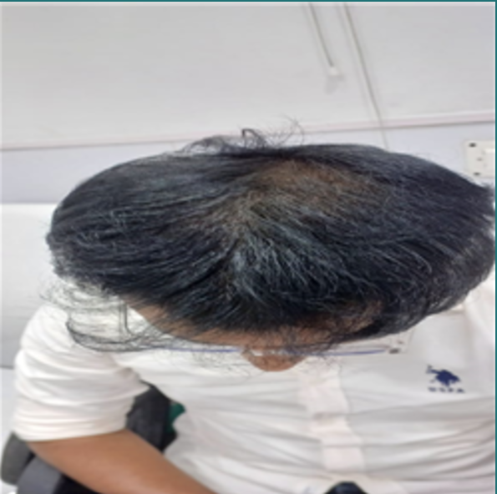
Dr Name: Dr Ruthumbhara
Clinic Name: BBSR
Sessions done: 6 sessions
Therapy taken: XOGEN
Therapsit name: Priyanka
Notes:
Enquiry Id : 110007965936

Slide 6
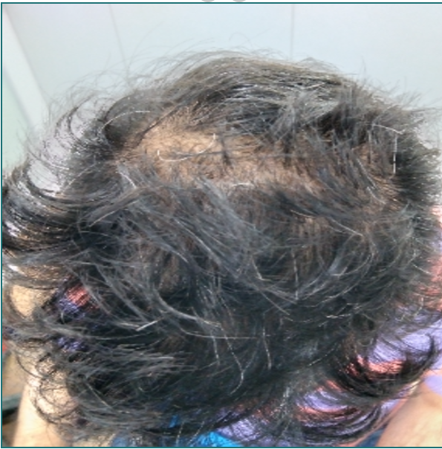
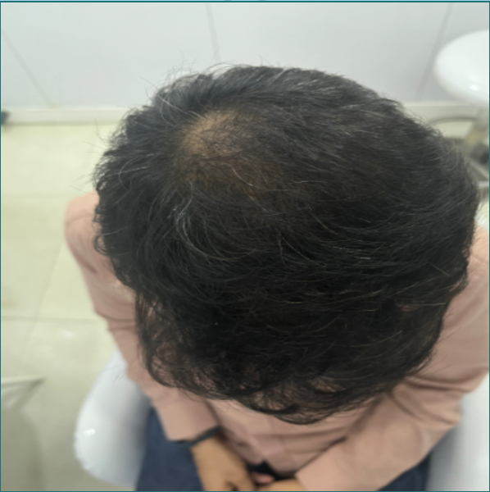
Dr Name: Dr Abhilash
Clinic Name: Janakpuri
Sessions done: 6 sessions
Therapy taken: XOGEN
Therapsit name: Poonam
Notes:
Enquiry Id : 110003188273

Slide 7
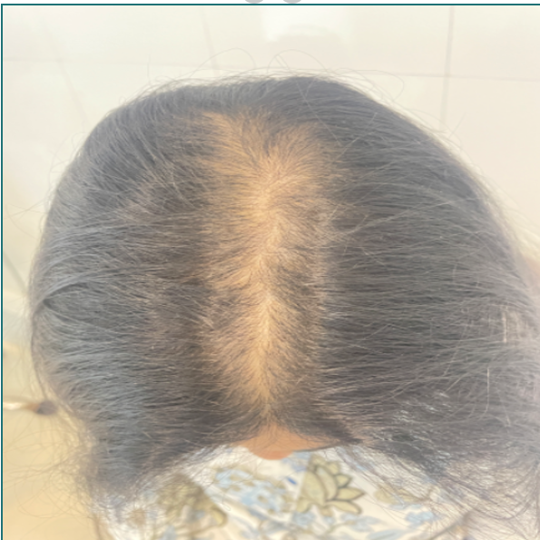
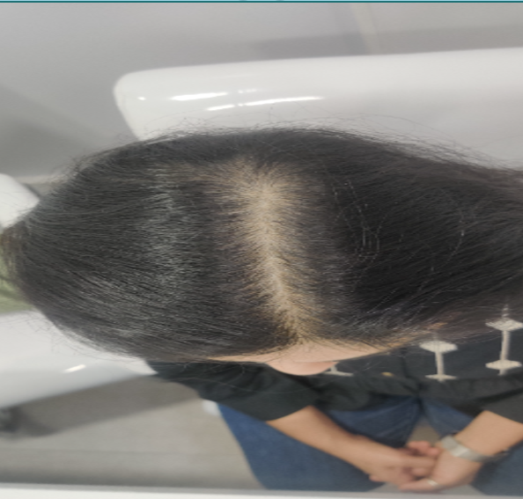
Dr Name: Dr Swecha
Clinic Name: East Delhi
Sessions done: 6 sessions
Therapy taken: XOGEN
Therapsit name: Anjali Mourya
Notes:
Enquiry Id : 110007187934

Slide 8
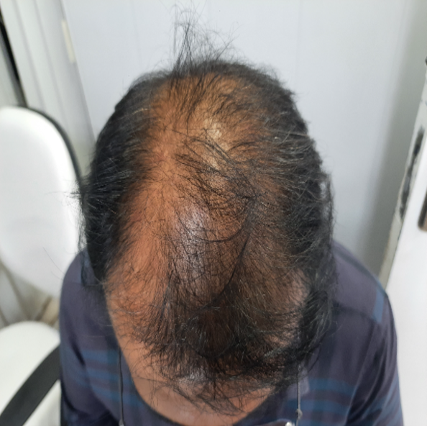
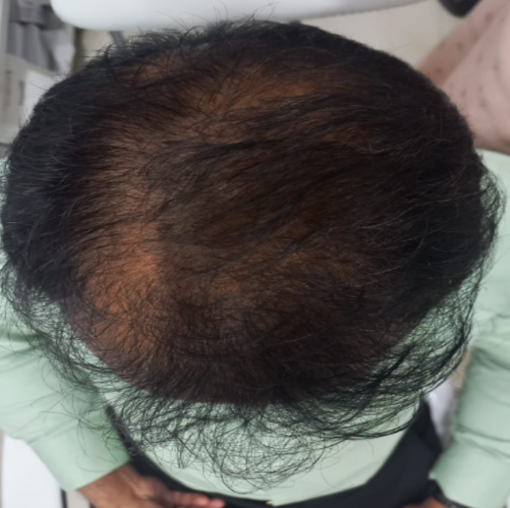
Dr Name: Dr Surbhi
Clinic Name: Indiranagar
Sessions done: 6 sessions
Therapy taken: XOGEN
Therapsit name: Mary Christina
Notes:
Enquiry Id : 110008058095

